Slide 1
Table Manners

Slide 2
Vocabulary
Etiquette: Manners or customs thought of as being polite and good practice.
  Dining Etiquette: Manners used
  when eating. Also known as table
  manners.

Slide 3

Table Manners
  Dining Etiquette Basics

Slide 4
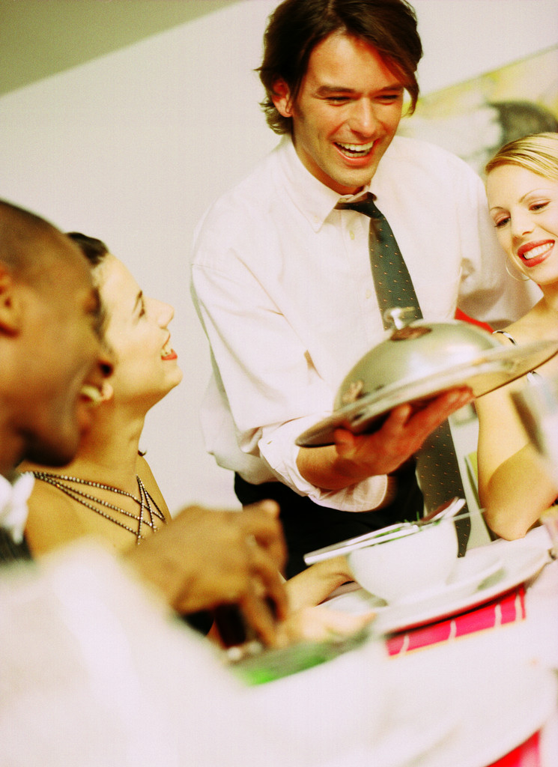
When to Start Eating
In a restaurant, wait until all the people at your table are served.
Wait until the host or hostess lifts their flatware to begin eating.

Slide 5
The Napkin
When you sit down, unfold your napkin and place it in your lap with the folded edge facing away from you.
When you finish your meal, place your napkin to the left of your plate, NOT on top of your plate.
If you leave the table, place your napkin on your chair.

Slide 6
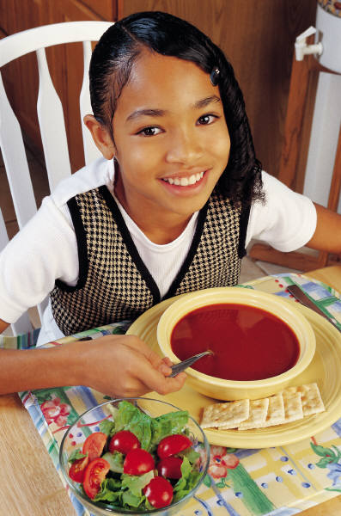
Elbows
Keep your elbows off the table.
Instead, rest your forearms against the edge of the table.

Slide 7
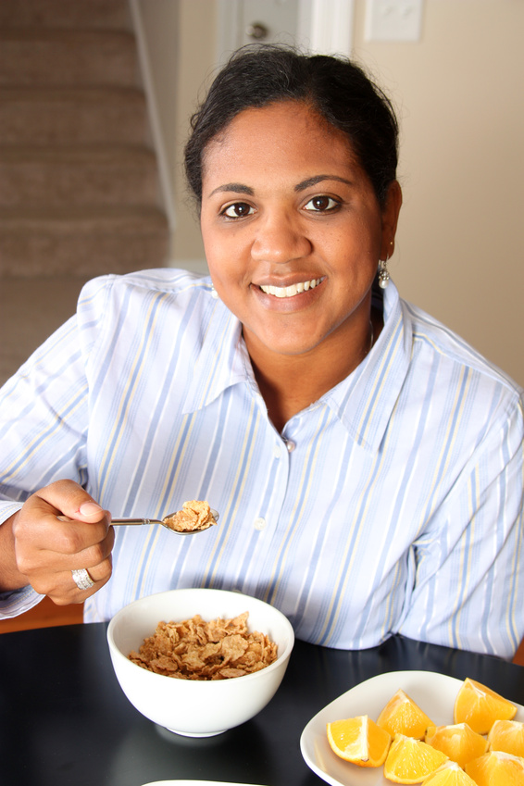
Eating
ALWAYS chew with your mouth closed.
Keep your head about one foot from you plate.
Bring the food to your mouth rather than bringing your mouth to the food!

Slide 8

Using Your Flatware
Start with the knife, fork, or spoon that is farthest away from you and work your way in, towards the plate.
Cut and eat small bites of food that do not cause you to struggle while you eat or stuff your mouth full of food.

Slide 9
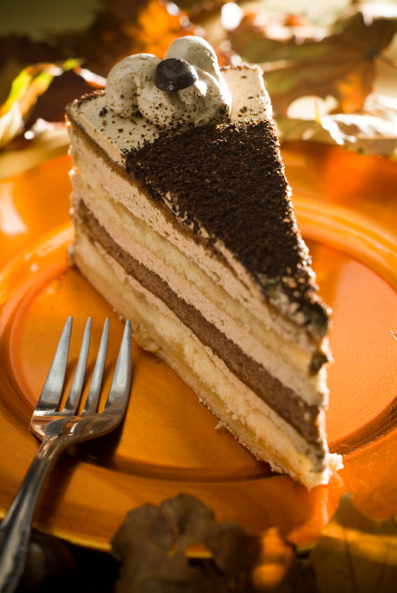
Using Your Flatware
Your used flatware should never touch the table.
In between bites, rest your knife or fork in the edge of your plate.
Do not hold food on your fork or spoon while talking or point with your flatware.

Slide 10
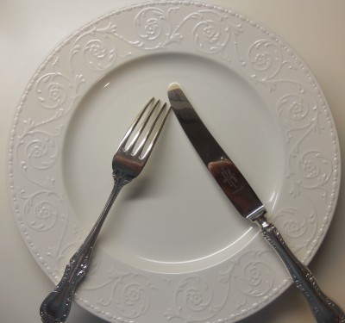
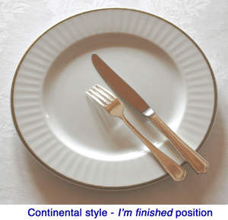
Using Your Flatware
If you are taking a break, place your knife and fork crossed towards the center of the plate
If you are finished eating, place you knife and fork together on the right side of the plate, diagonal to the table.

Slide 11
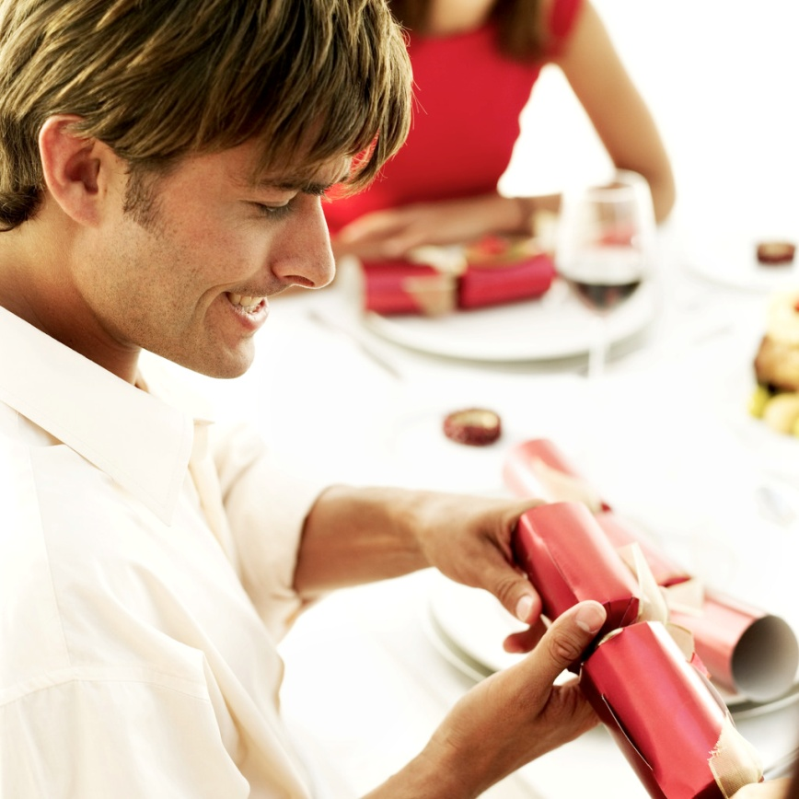
Passing Food
Pass dishes to the person nearest to you.
Pass dishes to the right and do not reach across the table or over other people.
If you would like a certain food or dish, ask the person closest to it to pass it to you.

Slide 12
Other Considerations
Do not talk with your mouth full of food.
Wait for the host or hostess to take their seats before sitting down.
Do not tell everyone you are going to the restroom, simply say “excuse me.”

Slide 13

Other Considerations
Loud eating noises, such as slurping or burping, are considered rude in American culture.
If you need to cough or sneeze, cover your mouth with your napkin. Do not blow your nose at the table.
Pace your eating with other guests.

Slide 14
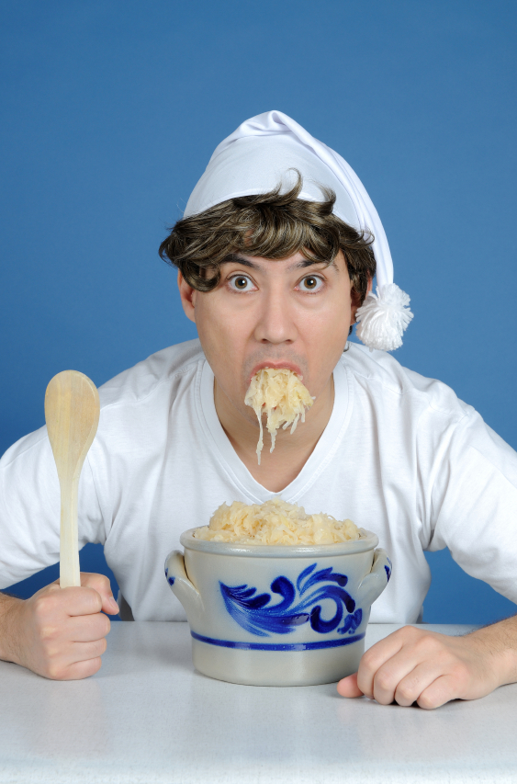
Other Considerations
Follow the dress code on the invitation or suggestions by the host or hostess.
Try to eat a little of everything on your plate.
Complement the host or hostess if you like the food, otherwise, stay quiet.
If you have dietary restrictions, let the host or hostess know before the event.

Slide 15

Table Manners Around the World
The table manners we practice in America are not always the same in other countries.
Can you think of any table manners practiced by some countries that we do not practice in the U.S.?

Slide 16
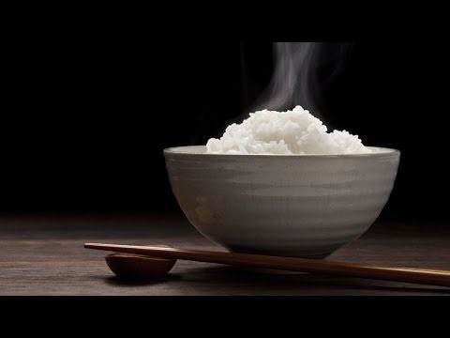
Table Manners Around the World

Slide 17
Academic Material
http://whatscookingamerica.net/Menu/DiningEtiquetteGuide.htm

