Slide 1
Recipes

Slide 2
Recipes
A recipe is a written record of ingredients and preparation steps needed to make a particular dish.

Slide 3
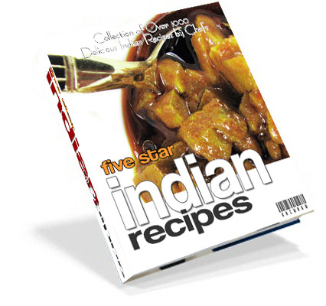
Recipes
Recipes can be found in many places, including cookbooks, blogs, magazines, websites, and even food packages.

Slide 4
Recipes
A well-written recipe should have 4 basic parts….
Title
Ingredients
Directions
Yield

Slide 5
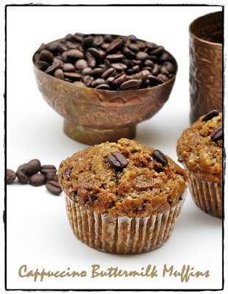
Title
A recipe’s title should be uncomplicated, easy to understand, and accurately describe the recipe.
This makes it easy for other people to search for and find the recipe.
Chocolate Surprise Cake vs. Buttermilk Chocolate Cake with Toffee Buttercream

Slide 6
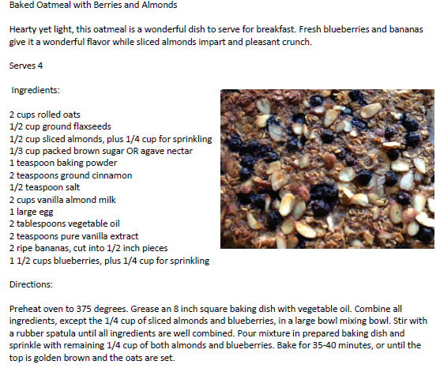

Slide 7
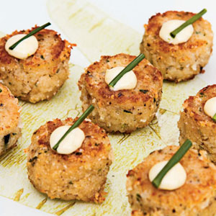
Yield
The yield is the amount of servings a recipe will make and may be shown using the words yield, servings, or serves X.
This is very important to include in a recipe because it tells you if one recipe is enough, too much, or just right for the number of people you plan to serve.
Perhaps you need to cut the recipe in half, double it, or even quadruple the recipe – the yield helps you decide.

Slide 9
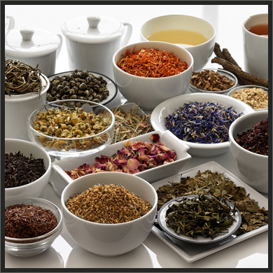
Ingredients
The ingredients section of a recipe tells you what items are needed to make a dish.
The ingredients should always be listed in order of their use.
The ingredients might be listed using weight (pounds, ounces), count (2 apples, 4 carrots), or volume (Tbs., tsp., cups, quarts).

Slide 10
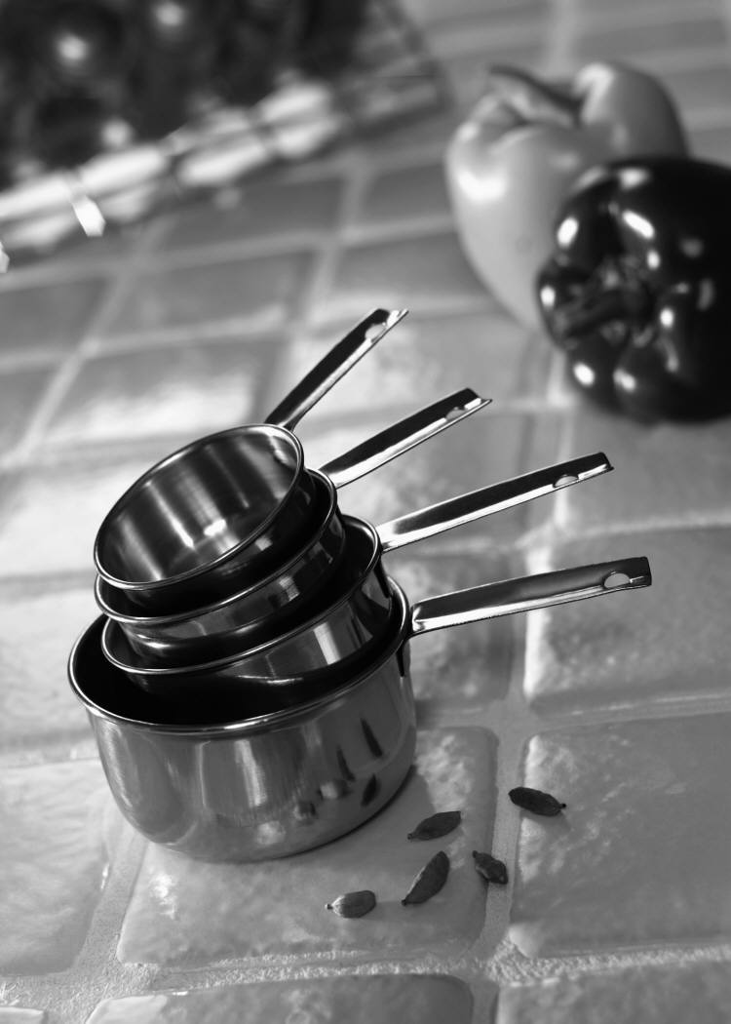
Ingredients
The amount of each ingredient used in the recipe is listed next to the name of the ingredient.
These amounts are often abbreviated.
Tablespoon = Tbsp. or Tbs.
Teaspoon = tsp.
Cup = c.

Slide 12
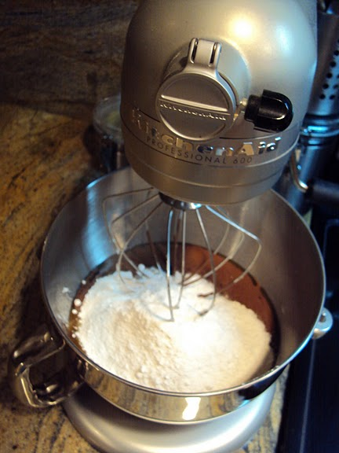
Directions
The directions give you step by step instructions on how to complete the recipe from start to finish using the items in the ingredients list.
The directions should match the order of items on the ingredients list.
Great directions tell the reader what type of equipment to use as well (sift flour in a large mixing bowl, stir with a rubber spatula).

Slide 14
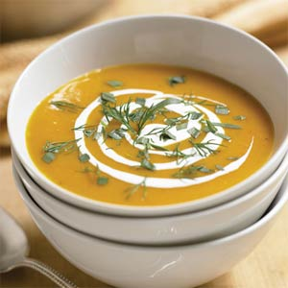
Other Features
Other recipe features include a description and pictures.
A description of a recipe is usually located at the top just after the title, and before the ingredients. It describes the dish in detail, giving the reader an idea of what flavors or appearance to expect.
Pictures are wonderful additions to recipes because they can show the reader what the dish looks like, and even show presentation and serving suggestions.

Slide 16
Working With a Recipe
Read the Recipe Completely
Gather Equipment and Ingredients
Prepare and Measure Ingredients (Mise en Place)
Begin the Cooking/Baking Process

Slide 17
Recipe Infographic
Infographic: A visual image used to represent information.
For this activity, you will use the recipe you brought from home and create an infographic that shows how to complete the recipe. You must show each step of the recipe process and should include pictures of cooking tools/ food/appliances.
You can only use short words/phrases and pictures in your infographic to explain the recipe.

Slide 18
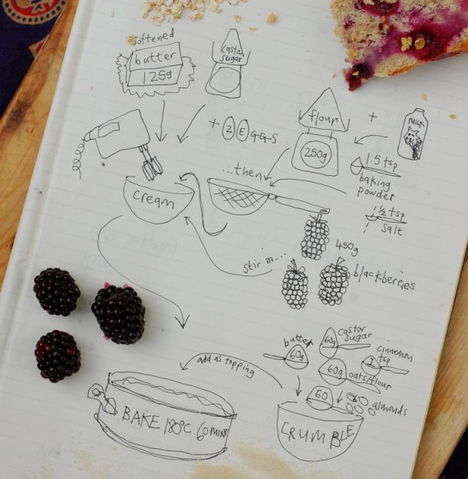
Recipe Infographic

Slide 19
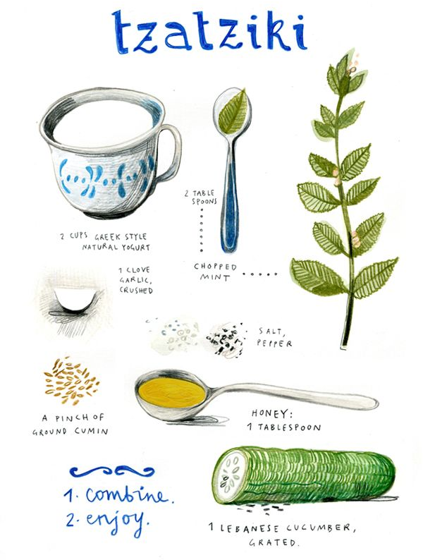
Recipe Infographic

Slide 20
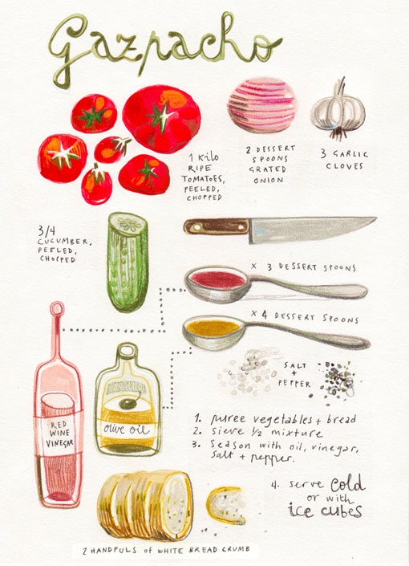
Recipe Infographic

Slide 21
Picture Credits
Recipes: http://www.zazzle.com/personalized_holiday_dinner_recipe_binder-127886580026014080
http://naadancurry.com/
Title: http://en.petitchef.com/recipes/cappuccino-buttermilk-muffins-virtual-connect-o-food-contest-fid-443455
Yield: http://www.myrecipes.com/recipe/maine-crab-cakes-with-lime-aoli-10000001665282/
Ingredients: http://www.smithtea.com/ingredients/
Directions: http://legeytimate.wordpress.com/2010/03/17/celebrate-ireland-with-an-offensive-cake/
Other Features: http://www.myrecipes.com/recipe/herbed-carrot-soup-10000001571519/

Slide 22
Academic Material
The Professional Chef: The Culinary Institute of America, 7th Edition (2002)
By
John Wiley & Sons, Inc.

