Slide 1
Meal Appeal

Slide 2
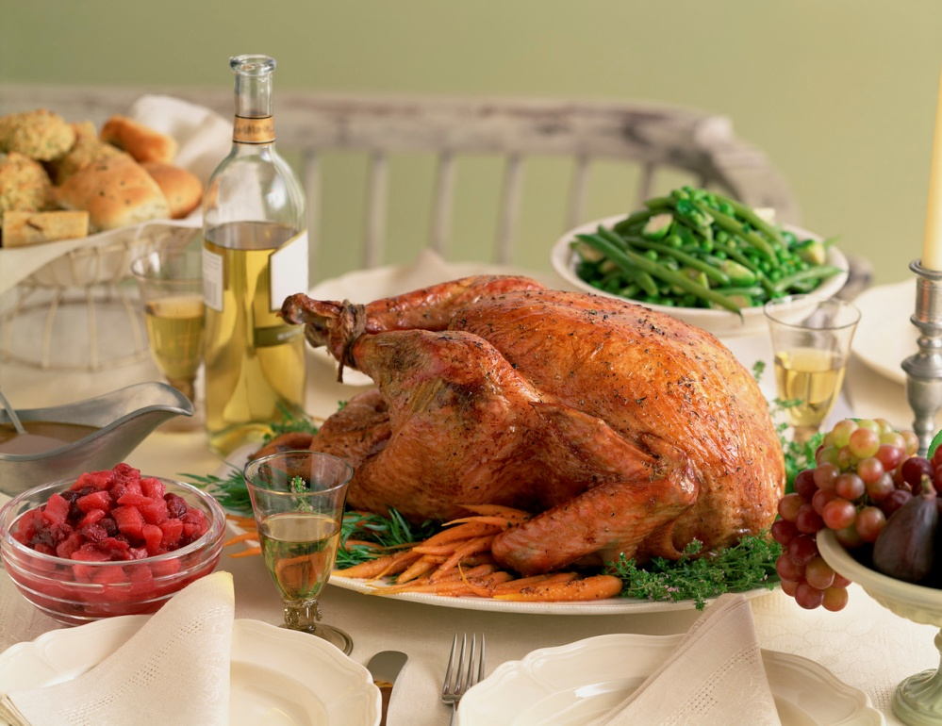
Meal Appeal
Well planned meals have an interesting combination of flavors, colors, and textures.
Some foods compliment, or go together, better than others.
Macaroni and cheese
Turkey and cranberry sauce

Slide 3
Meal Appeal
Meal Appeal
Flavor
Color
Texture
Shape and Size
Temperature

Slide 4
Flavor
Flavor describes what the food tastes like.
Sweet (candy)
Sour (green apple)
Salty (popcorn)
Bitter (dark chocolate)
Umami (meaty)
Combine flavors that are different, but that complement one another.
Sweet and Sour Chicken
Kettle Corn
Chocolate Covered Bacon

Slide 5
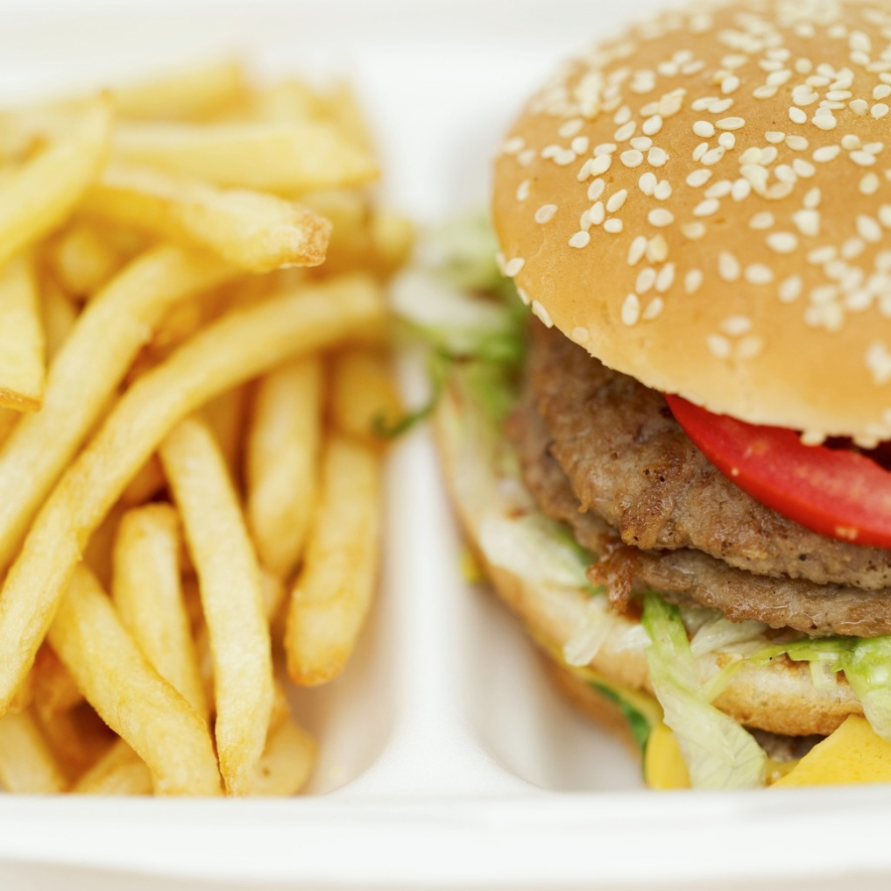
Color
Choose foods that have a variety of colors rather than those that are all the same.
Use fruits, vegetables, and garnishes to add color.

Slide 6
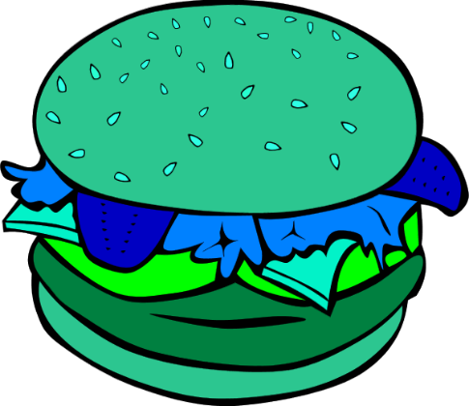
Color

Slide 7
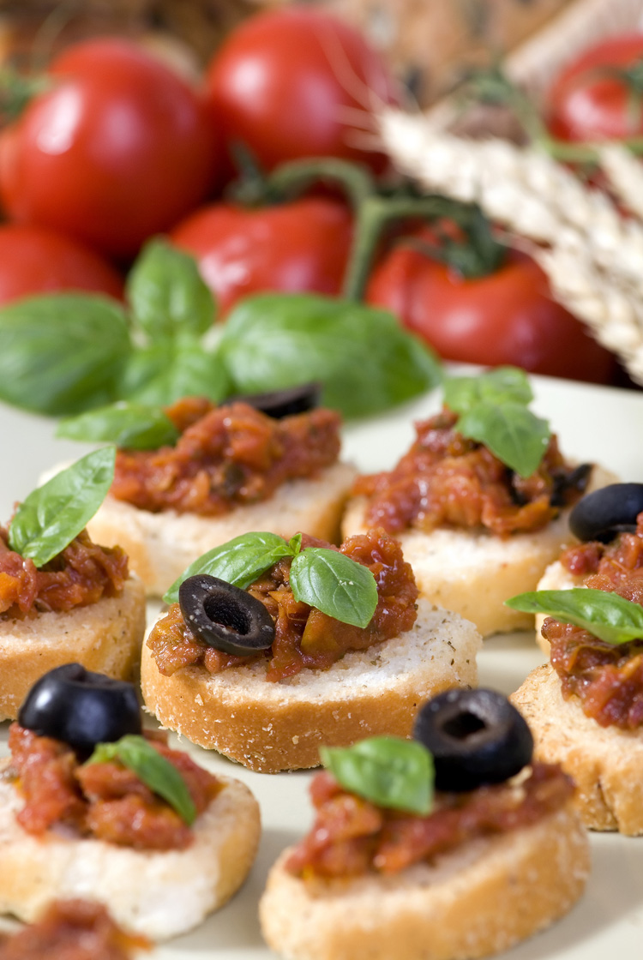
Texture
Texture is the way the food feels when you chew it.
You can change the texture of foods depending on how you cook them (mashed potatoes v. french fries)
Choose foods with a variety of textures.
Tomato soup with grilled cheese
Spaghetti with cesar salad

Slide 8
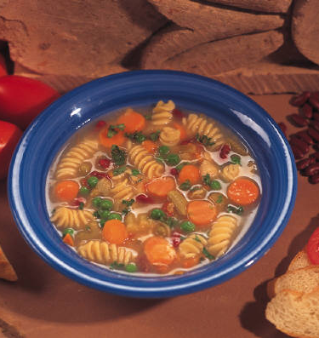
Shape and Size
Add variety by preparing foods that are different shapes and sizes.
Vegetable Stir Fry
Minestrone Soup
Chicken and Dumplings
Keep in mind: The size and shape should not be so different that it makes the dish difficult to eat.

Slide 9
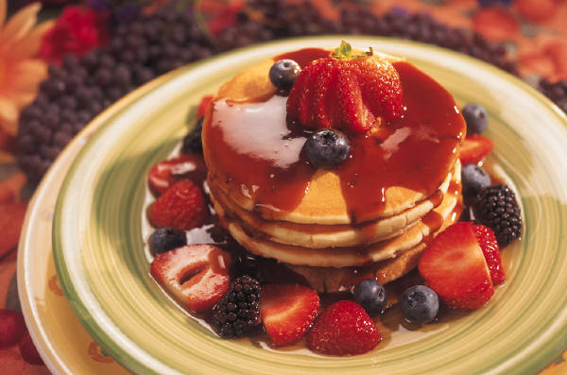
Temperature
Temperature impacts a food’s taste and texture, as well as its safety.
Choose foods that have different temperatures when planning a meal.
Potato salad and cheeseburgers
Shrimp and vegetable tempura with seaweed salad
Enchiladas with avocado and salsa

Slide 10
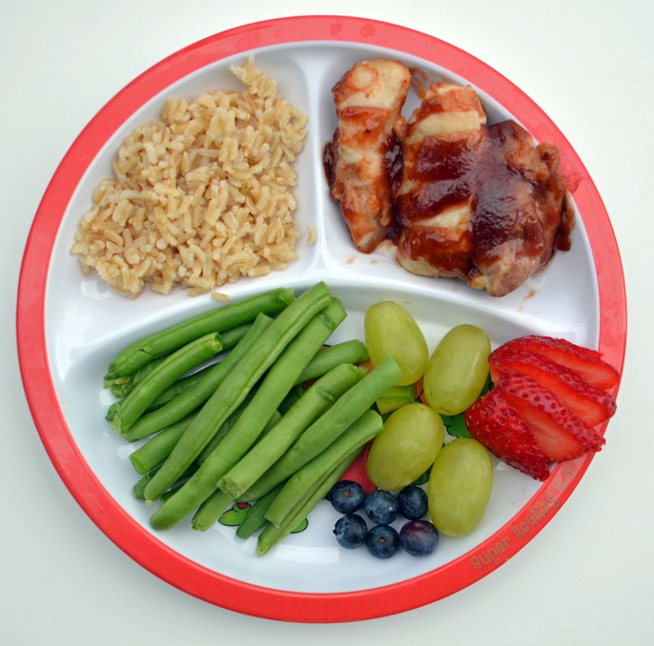
Healthy Plates

Slide 11
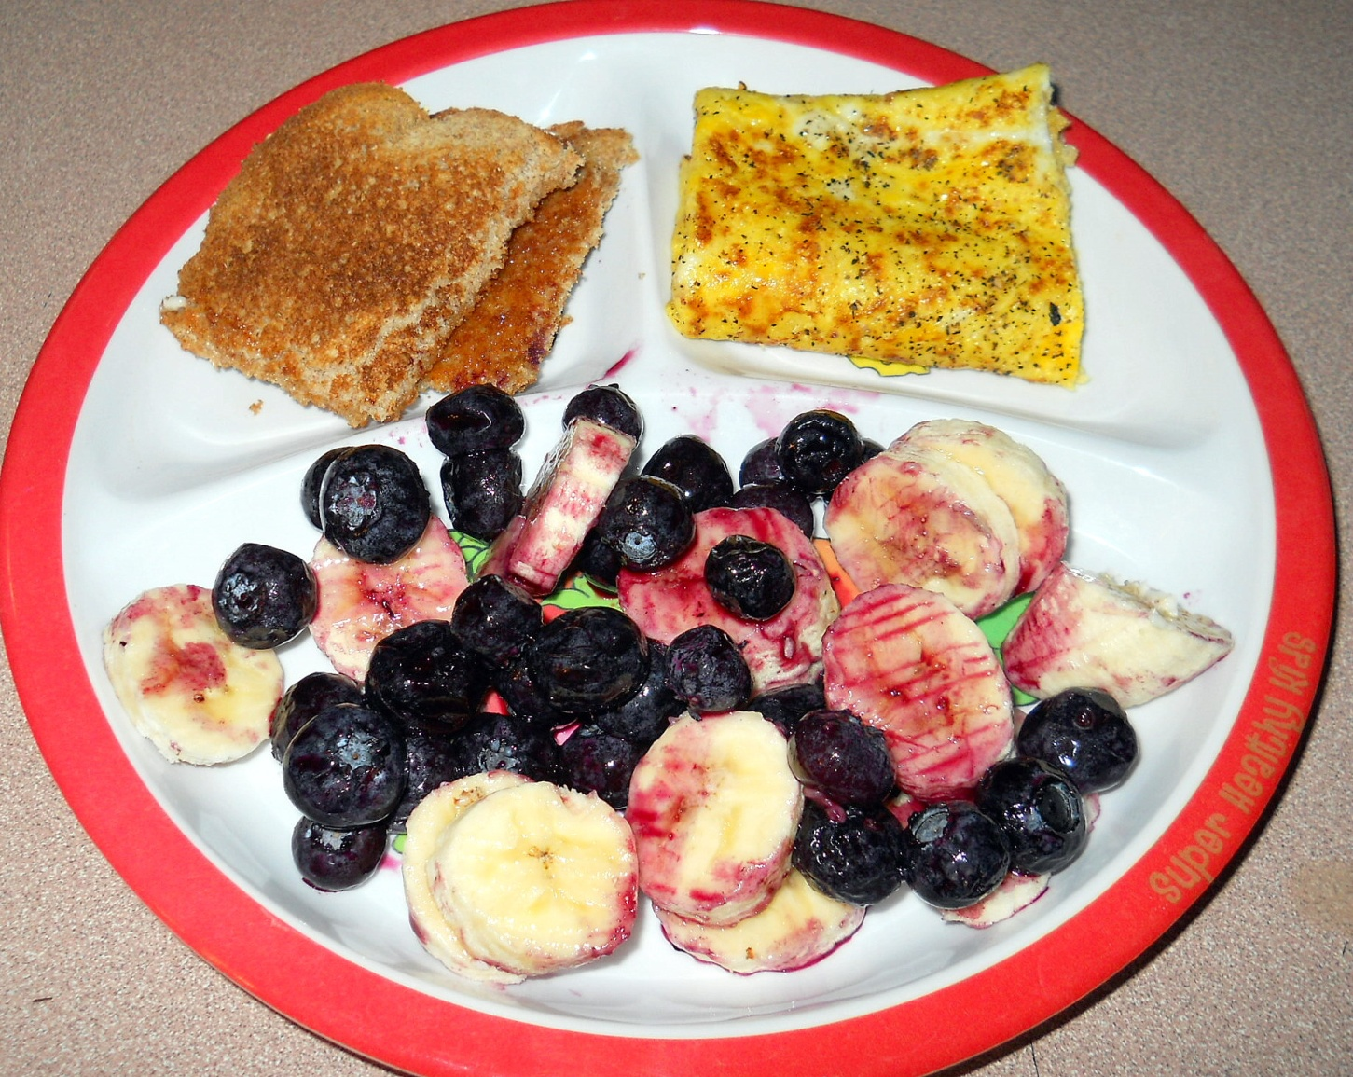
Healthy Plates

Slide 12
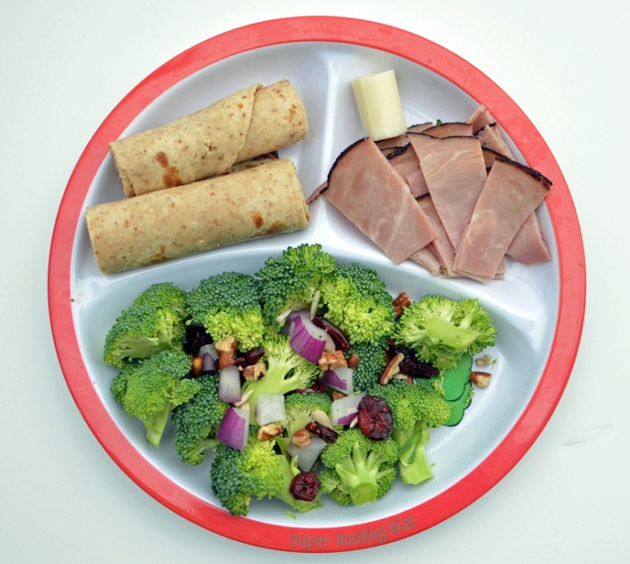
Healthy Plates

Slide 13
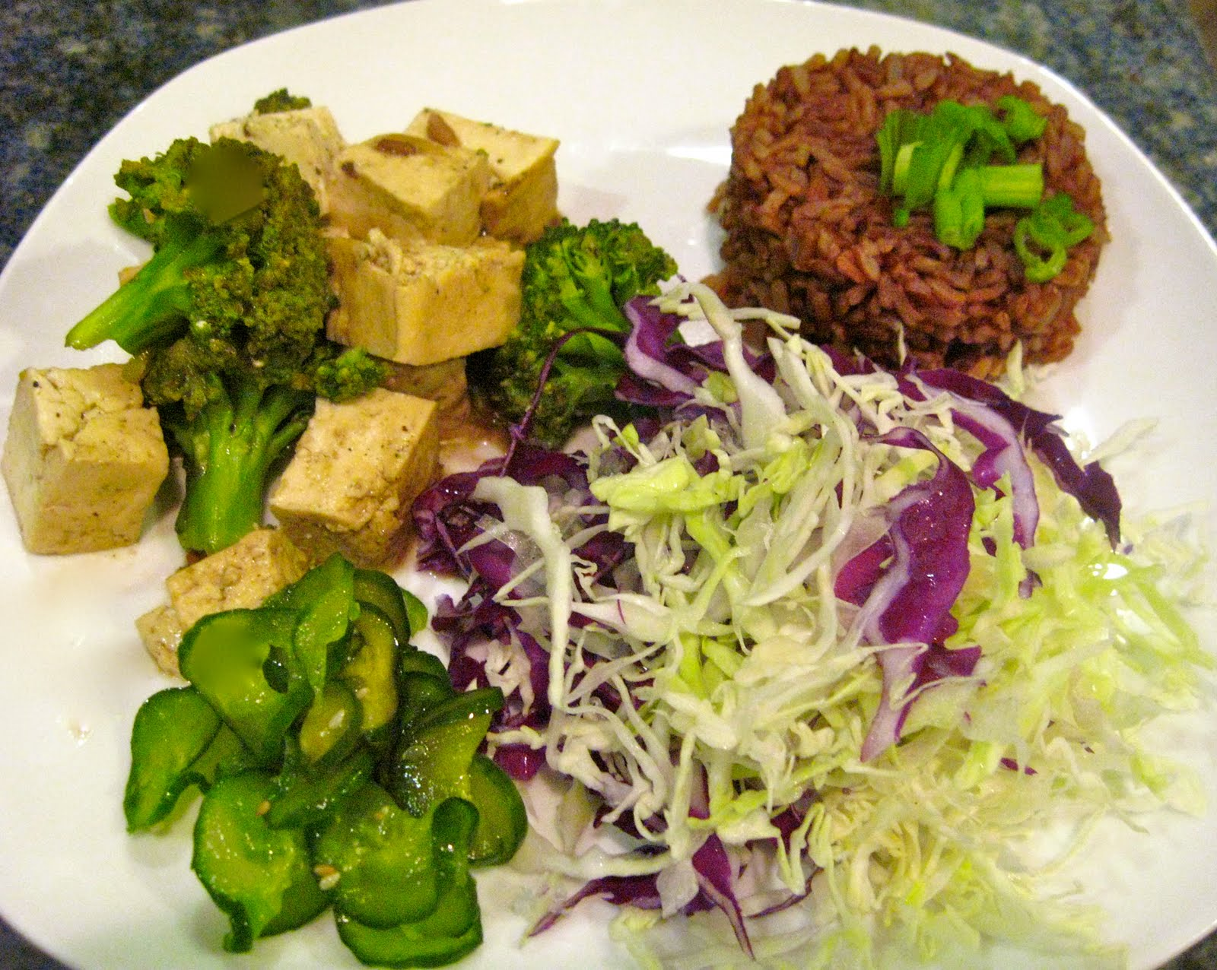
Healthy Plates

