Slide 1
Healthy Meal Planning and Weight

Slide 2
Vocabulary
Healthy Meal Planning: Creating meals that are balanced, nutrient dense, and that have the correct serving sizes.
Serving Size: A portion of food that allows for a balance of other foods and nutrients (not too much, not too little).

Slide 3
Healthy Meal Planning
Eat These
Colorful Fruits and Vegetables
Whole Fruit
Limit These
Too Much Meat
Fatty Meats
Whole Grains
Lean Proteins
Beans and Legumes
Nuts and Seeds
Mono and Polyunsaturated fats
Saturated Fats
Highly Refined Carbohydrates
Highly Processed Foods
Foods with a low nutrient density

Slide 4
Healthy Meal Planning
45% to 65% of calories eaten should come from carbohydrates.
20% to 35% of calories eaten should come from fat.
10% to 35% of calories eaten should come from protein*

Slide 5
Basic Food Groups
Food Groups
Grains
Vegetables
Fruit
Dairy
Meats, Beans, Eggs, Nuts, and Seeds
Added Fats

Slide 6

Recommended Serving Sizes
Turn to pages 138 and 139 in your books
In your journals, answer the following questions:
  What is a serving of vegetables?
  What is a serving of meat?
  What is a serving of bread?
  What is a serving of rice or pasta?
  What is a serving of fruit?

Slide 7
Types of Nutrients
Protein
  Complete
  Incomplete
  Combination
Fats
  Saturated
  Unsaturated
  Trans
Carbohydrates
  Simple
  Complex

Slide 8
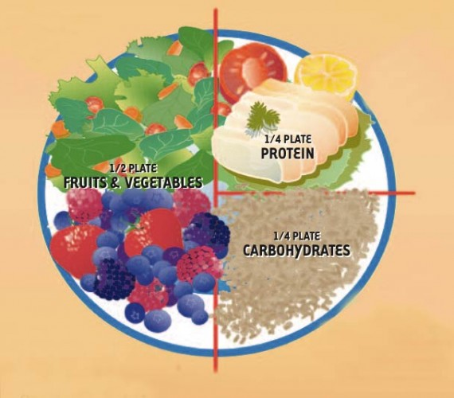
Healthy Plate

Slide 9
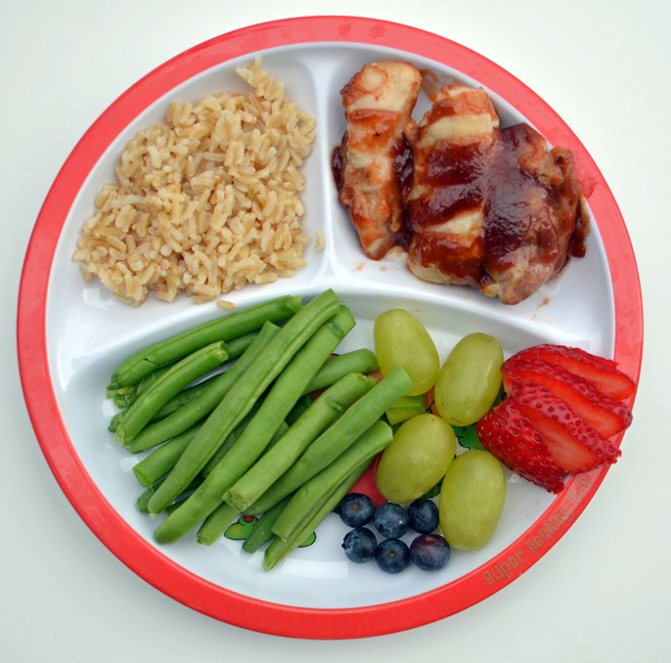
Healthy Plates

Slide 10
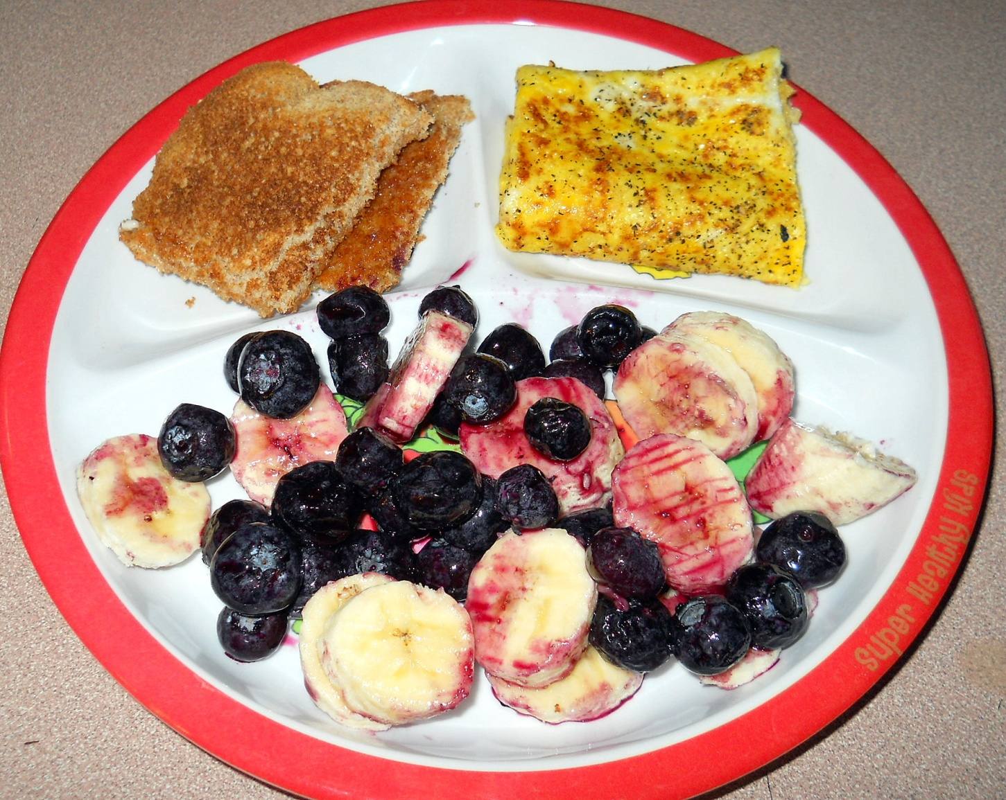
Healthy Plates

Slide 11
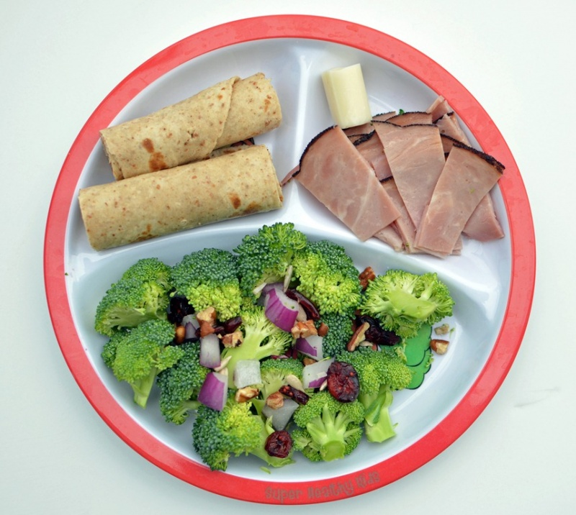
Healthy Plates

Slide 12
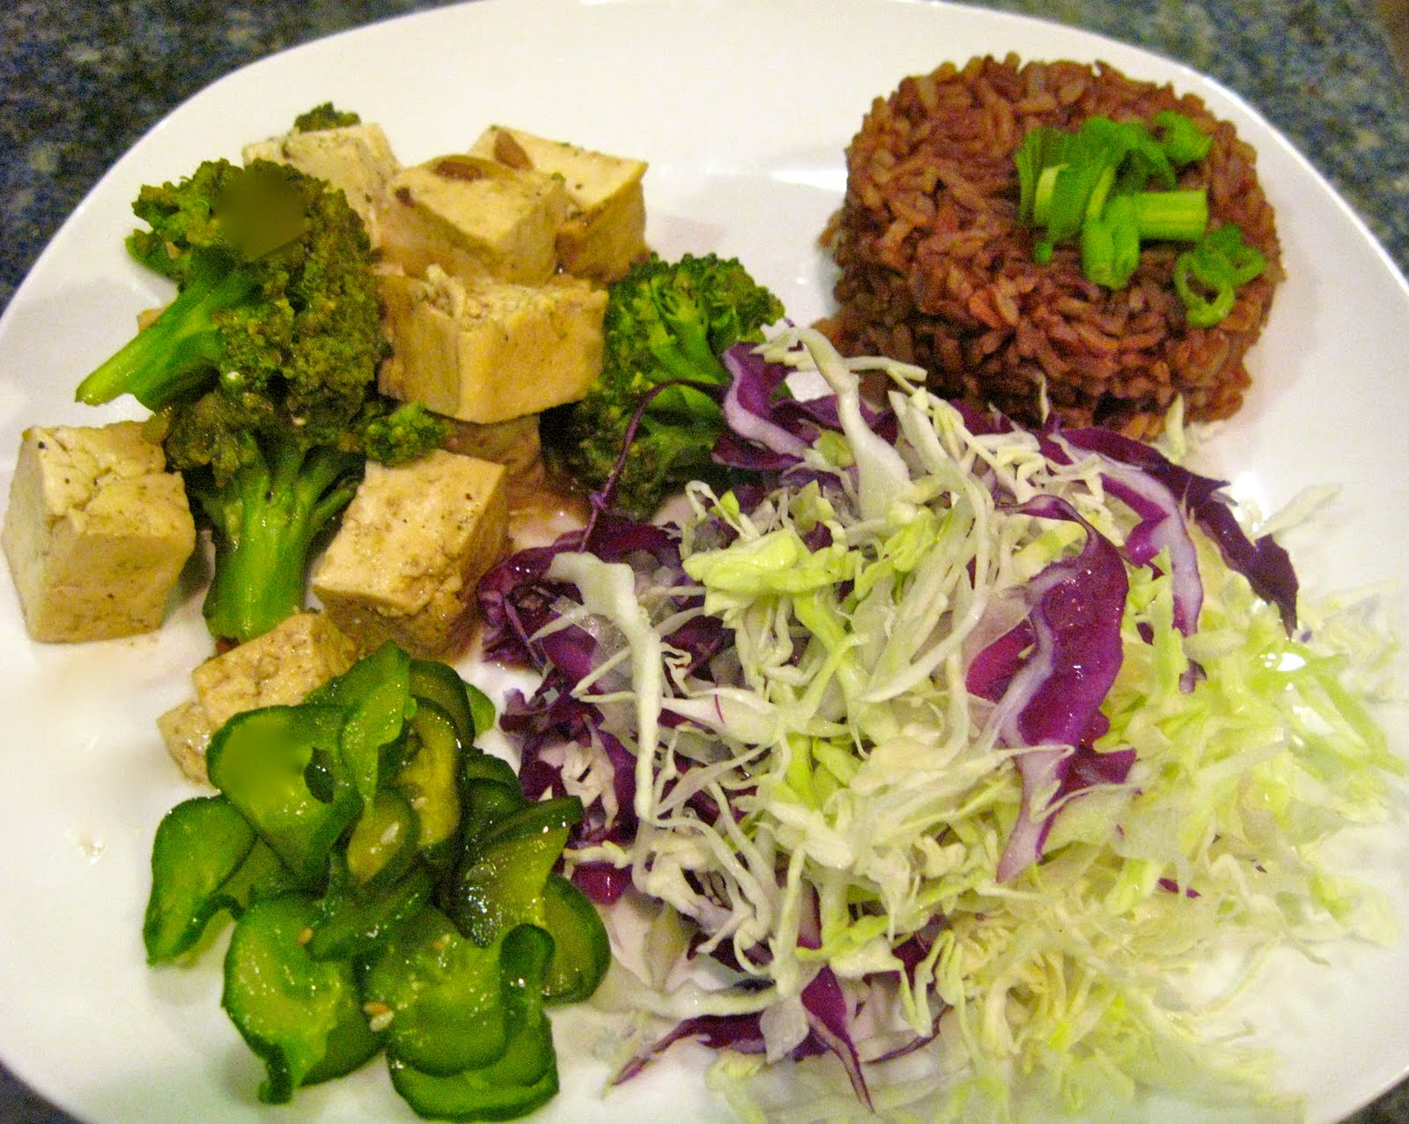
Healthy Plates

Slide 13
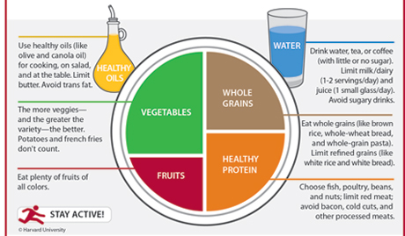
Healthy Plate Activity

Slide 14
Maintaining a Healthy Weight
Weight is a difficult subject in our society.
We are pressured to be a certain size and weight.
Your size and weight aren’t necessarily a predictor of good health.

Slide 15
How to Achieve a Healthy Weight
Eat a mainly plant-based diet made up of whole foods.
Pay attention to portions.
Eat nutrient-dense foods, or those with a high amount of nutrients per calorie.
Stay active and exercise for an hour a day.
Be aware of calories in, calories out.

Slide 16
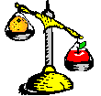
Energy Balance
When you take in the same amount of energy you use, you have energy balance.

Slide 17
Weight Gain and Loss
There are 3500 calories in one pound.
If you want to lose weight, you must burn more calories than you eat.
  1 to 2 pounds per week through exercise, food choices, and portion control is reasonable and safe for most people.
If you want to gain weight, you must take in more calories than you use and/or increase your weight training

