Slide 1
Food Labels

Slide 2
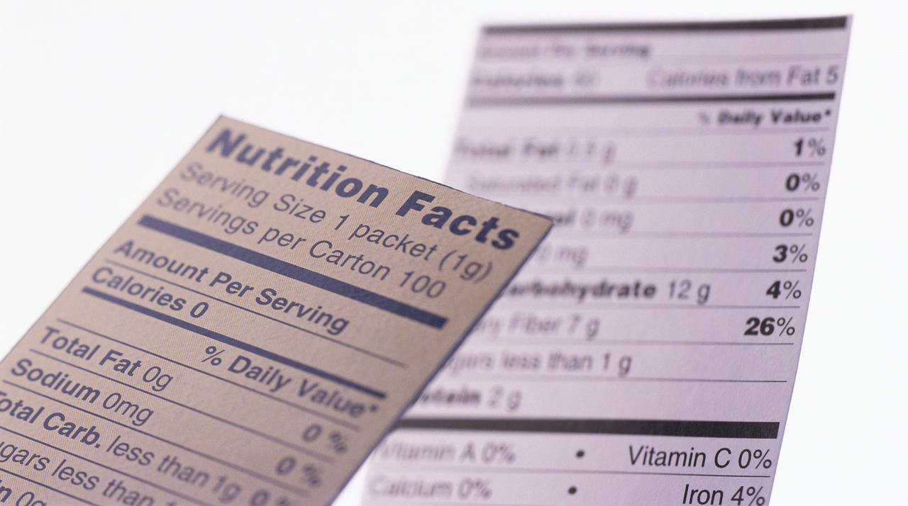
Food Labels
Food labels help us determine the nutrient content of foods. They are required for most prepared foods, except those that don’t provide many nutrients, such as coffee and spices.

Slide 3
Components of Food Labels
Food Labels
Product Name
Net Contents
Nutrition Facts
Ingredients
Name and Address of the Manufacturer
Nutritional Claims
Sell By/ Expiration Date

Slide 4
Product Names
Food labels always contain the name of the product.
Don’t always trust the label: Kraft’s Guacamole Dip contains less than 2% avocado.
The ingredients list is a more accurate way to determine what you are eating.

Slide 5
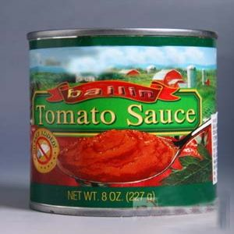
Net Contents
Net contents tells you the weight, count, or quantity inside the package.

Slide 6
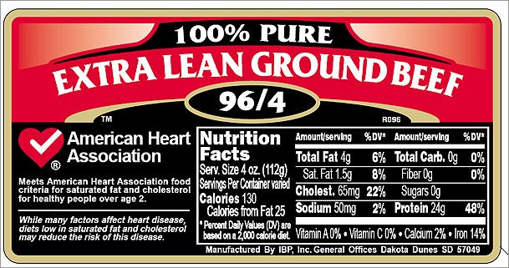
Name and Address of the Manufacturer
The name and address of the manufacturer is important because it tells you who to contact in the event you have file a complaint about the product.
You can also write to the manufacturer to complement their product- they may send you coupons in return.

Slide 7
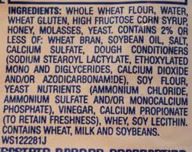
Ingredients List
For foods with more than one ingredient, the ingredients are listed underneath the nutrition facts panel.
The ingredients are listed in descending order by weight, meaning the first ingredient makes up most of the weight of the product, followed by the second ingredient, and so on.

Slide 8
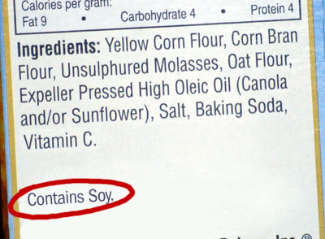
Ingredients List
Some ingredients labels list common allergies found in their processing plants, even if they are not contained in the particular food product.

Slide 9
Nutritional Claims
Low Fat, Sugar Free, Low Calorie…
Newer Terms: Vegan, Gluten Free, Trans Fat Free…

Slide 10
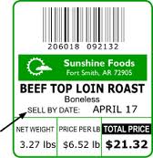
Sell By and Expiration Date
Sell By Date tells you the product should be sold by the store by this date. It can still be consumed for up to a week after this date.
Expiration Date tells you the last day the product should be consumed.
Best By Date tells you the last date the product is at its freshest. It can still be eaten after this date.

Slide 11
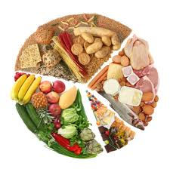
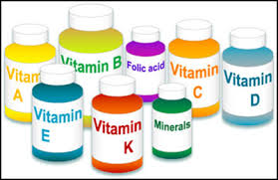
Important Vocabulary
Macronutrients: People need to eat these nutrients in large quantities.
Protein
Fat
Carbohydrates
Micronutrients: People need to eat these nutrients in small quantities.
Vitamins
Minerals

Slide 12
Nutrition Facts Panel
Number of Servings and Serving Size
Calories per Serving
Macronutrients
Micronutrients
Percent Daily Value

Slide 13
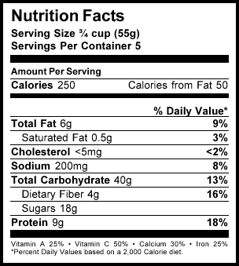
Servings
At the top of the Nutrition Facts panel, you will see the serving size and the number of servings in the package.
The rest of the information on the label is based on a single serving of the product.
If a product contains less than half a gram of a nutrient per serving, it can be rounded down to zero.

Slide 14
Calories
Calories on the food label tell you how much energy is in the food product.
Carbohydrates, Proteins, Fats, and Alcohol are the only items that contribute calories.
Carbohydrates
4 calories per gram
Proteins
4 calories per gram
Fats
7 calories per gram
Alcohol
9 calories per gram

Slide 15
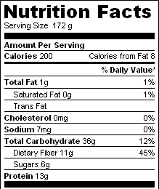
Macronutrients
Fats, carbohydrates, and proteins can be found on nutritional panels.

Slide 16
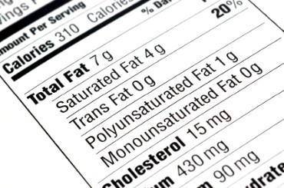
Macronutrients: Fats
Total Fat includes …
saturated fat
trans fat
monounsaturated fat
polyunsaturated fat
Only saturated and trans fats are required to be listed under total fat.
Cholesterol must also be placed on the food label.

Slide 17
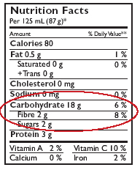
Macronutrients: Carbohydrates
Total Carbohydrate includes the total amount of sugars, fiber, and starch.
Most of the time, only sugars and starches are included in calculating the total calories because fiber does not add calories to the product.

Slide 18
Macronutrients: Protein
Protein can be found towards the bottom of the nutrition panel.
The panel does not always list a recommended amount of protein like it does for the other nutrients because this is based on your body weight.
You need at least 0.36 grams of protein per pound.
Weight X 0.36 = needed protein

Slide 19
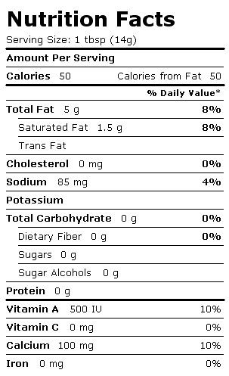
Micronutrients
The nutrition facts panel must also list certain vitamins and minerals.
Vitamin A
Vitamin C
Calcium
Iron
Sodium
Just because a vitamin or mineral is not listed does not mean it isn’t in the product.

Slide 20
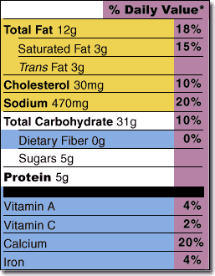
Percent Daily Value (DV)
Percent daily values (DV) tell you how much the nutrients in your food contribute to the recommended amount of nutrients a person eating 2,000 calories a day should eat.
5% or less = poor source
10%-19% = moderate/ good source
20% and over = high source

Slide 21
Picture Credits
Product Names:
Net Contents: http://www.bombayharbor.com/Product/33382/Canned_Tomato_Paste.html
Name and Address of the Manufacturer: http://blog.goodguide.com/page/2/
Ingredients List: http://ls1tech.com/forums/racers-lounge/1589829-lunchtime-eating-healthy.html
http://www.riversideonline.com/health_reference/Immune-System/AA00057.cfm
Calories:http://thewhitneyway.wordpress.com/2012/02/13/lets-talk-about-food-labels/
Macronutrients: http://nutritiondata.self.com/
Macronutrients: Fats: http://www.myfoodnfitnessdiaries.com/2011/11/25/guest-post-nutrition-labels/
Macronutrients: Carbohydrates:http://www.kraftcanada.com/en/healthy-living-ideas/diabetes/nutritionknowhow/carbohydratecounting.aspx
Micronutrients: http://www.quitehealthy.com/nutrition-facts/country-crock/L379251.html
Percent Daily Value: http://thediabetesclub.com/not-reading-nutrition-labels-can-cost-you-dear-part-4/

