Slide 1
Food-Borne Illness

Slide 2


Slide 3
Important Vocabulary
Contaminate: To make something impure, unclean, polluted, or harmful.
Food Borne Illness: Sickness caused by eating foods that have gone bad or are contaminated.
Microorganism: A tiny living thing that can only be seen under a microscope.

Slide 4
Food-Borne Illness Facts
Sickness depends on what the food is contaminated with, how much of it you eat, and how vulnerable you are.
Children, the elderly, and people with weak immune systems have trouble fighting food-borne illness.

Slide 5
Food Contamination
Food Contamination
Chemical
Physical
Biological

Slide 6
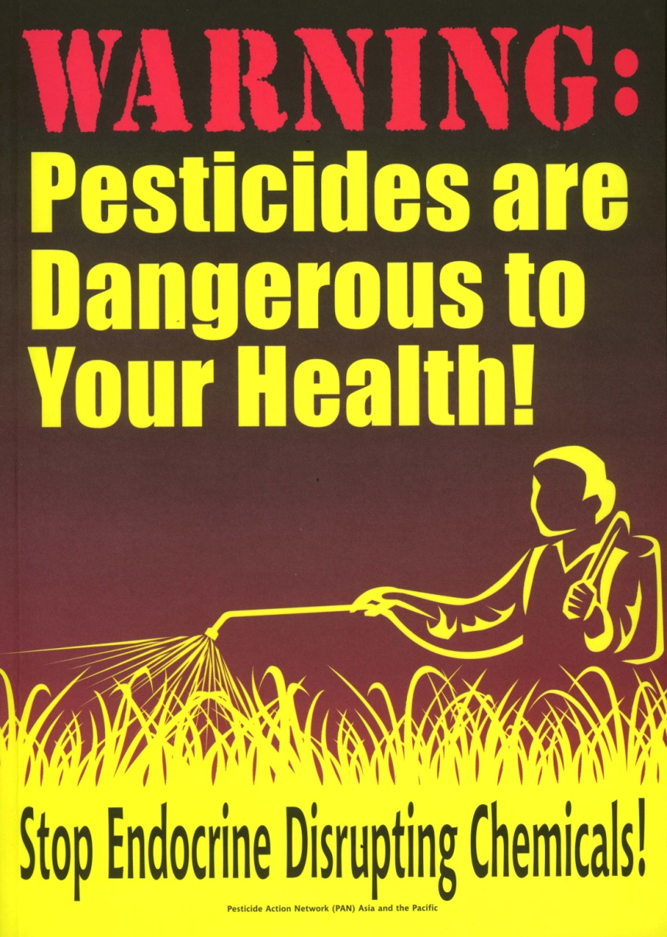
Chemical
Insecticides and cleaning agents are examples of chemical contaminants that may find their way into foods.

Slide 7
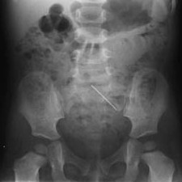
Physical
Physical contaminants include things like bits of glass, rodent hairs, paint chips, and metal.

Slide 8
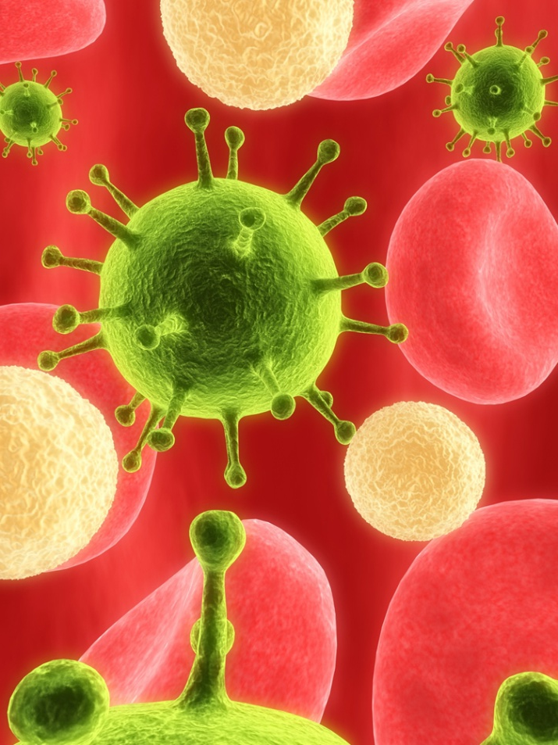
Biological
Biological contaminants account for most of food-borne illnesses.
Most biological contaminants are disease-causing microorganisms, called pathogens, that cause 95 percent of all food-borne illnesses.
  Intoxication happens when a person eats a food containing toxins from bacteria, molds, plants or animals.
  Infection happens when the food eaten by a person has a large number of living pathogens that multiply in the body and attack the gastrointestinal lining.

Slide 9
Common Food Borne Illnesses
Costridium Botulinum commonly known as botulism; found in cans and jars , can cause death.
E. coli - found in the intestines of warm blooded animals like beef; vegetables – green onions, spinach.
Salmonella – found in chicken, eggs.
Staphylococcus – humans (sneeze, cough, cuts).

Slide 10
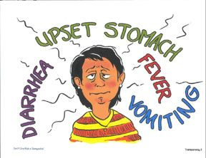
Symptoms of Food Borne Illness

Slide 11
Microorganisms that Cause Food-Borne Illness
Parasites
Fungi
Viruses
Bacteria
Mold and yeast
Usually just causes food to spoil
Contaminates food
Then multiplies in the body
Doubles every 20 minutes!
Needs moderate Ph, temperature, protein, and moisture
Feeds on (eats) a host.
Host suffers/dies
Botulism, salmonella, staph
Hepatitus
Worms, trichinosis, giardia

Slide 12
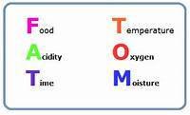
Avoiding Contamination
Thaw
Prepare
Cook
Hold
Cool
Reheat
Store

Slide 13
Thawing Food
Refrigerator
Best, Safest, and Slowest.
Place food in a drip pan to avoid cross contamination
Sink
Cover or wrap the food and place in clean sink.
Microwave
Somewhat Safe.
Run cold water over food until thawed.
Food must be cooked IMMEDIATELY after thawing in the microwave.

Slide 14
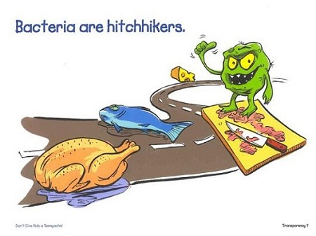
Prepare Food Properly
Cross contamination happens when pathogens or harmful substances are transferred from one contaminated surface or food to another.
Never let raw meats touch cooked food or plant sources of food, like fruits and vegetables.
Equipment and cutting boards that have touched raw meat should be cleaned and sanitized before being used for fruits and vegetables.

Slide 15
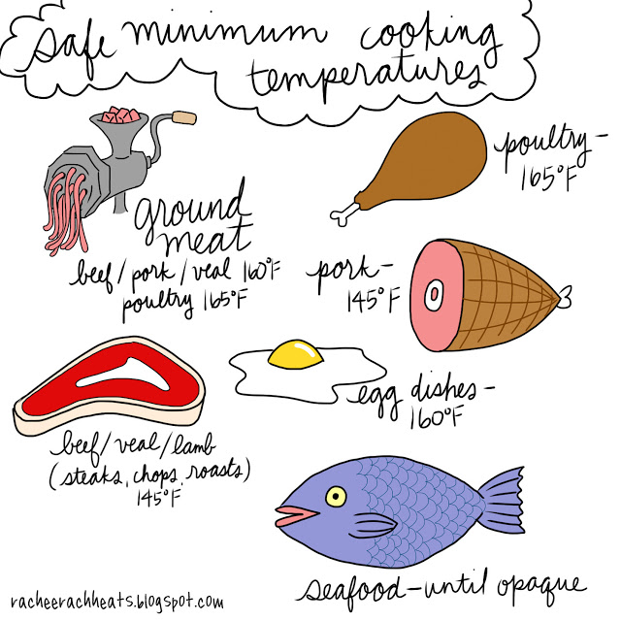
Cook Food Properly

Slide 16
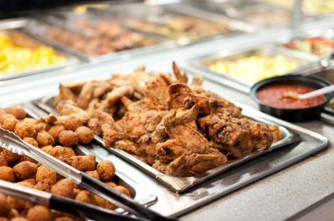
Holding Food
Keep hot foods hot and cold foods cold.
Microorganisms are most likely to grow between 40 and 140 degrees, or the danger zone.
  Keep hot foods at or above 140 degrees
  Keep cold foods at or below 40 degrees.

Slide 17
Holding Food
Food can only be held for 2 hours at room temperature and 1 hour if the temperature is above 90 degrees!

Slide 18
Cooling Food
Food Safety Tip: Cool food in shallow containers so it cools faster!!
Cool to 70 ̊ F in 2 hours
Cool to 40 ̊ F or below in 4 hours
Total Cooling Time: 6 hours

Slide 19
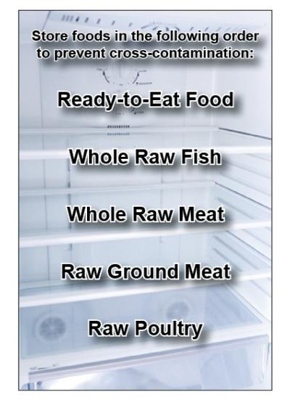
Store Food Properly
All food must be stored carefully to prevent contact between raw and cooked items.
Place drip pans beneath raw foods to catch drips and prevent splashing.
Items should be stored properly and arranged according to what temperature they are cooked to.

Slide 20
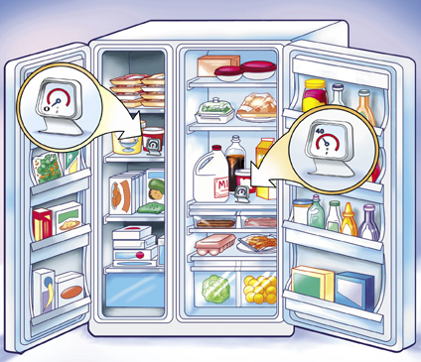
Store Food Properly
Store foods in clean containers that are covered or wrapped and dated.
Throw away leftovers after 7 days.
Refrigerated foods should be stored between 36 and 40 degrees.
Frozen foods should be stored at or below 0 degrees.

Slide 21
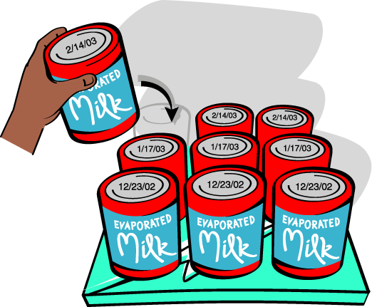
Store Food Properly
FIFO stands for First In, First Out.
When new foods are brought in, older foods should be moved to the front, and newer foods should be put in back.

Slide 22
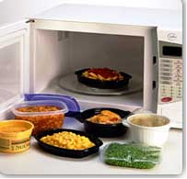
Reheating Food
Leftover foods that are being reheated should be heated to at least 165 degrees for 15 seconds.

Slide 23
Picture Credits
Chemical: http://www.lowdensitylifestyle.com/obesity-can-be-caused-by-chemicals-in-foods/
Physical: http://www.popfi.com/2009/11/12/15-pounds-of-nails-removed-from-mans-stomach/
Fungi: http://www.missouribotanicalgarden.org/gardens-gardening/your-garden/help-for-the-home-gardener/advice-tips-resources/pests-and-problems/diseases/fruit-spots/gray-mold-of-strawberry.aspx
Viruses: http://health.howstuffworks.com/medicine/modern-technology/light-virus.htm
Parasites: http://thecuriousorchid.com/?p=253
Bacteria: http://bacteriakingdom.freeoda.com/
Avoiding Contamination: http://www.asgdine.com/blog/bid/55873/Best-Ways-to-Prevent-Food-Contamination
Cross Contamination: http://ucanr.org/sites/foodsafety/Make_it_Safe-_Keep_it_Safe/-4_Rules_of_Food_Safety_To_Prevent_Foodborne_Illness/
http://www.cortlandasc.com/dining/food-safety-guidelines.cfm
Proper Storage: http://www.shelfreliance.com/blog/index.php/tag/food-storage/
FIFO: http://www.nfsem.com/2003/illustrations.aspx
Holding Food: http://www.pricemykitchen.com/tag/hot-food-tables/
Cooling Food: http://www.foodiq.us/?page_id=446
Reheating Food: http://www.plasticsinfo.org/Main-Menu/MicrowaveFood/CookingStorage-Tips/Love-Your-Leftovers/Kitchen-Savvy-Dos-for-Storing-and-Reheating-Leftovers.html
Thawing Food, Refrigerator: http://couponingtodisney.blogspot.com/2009/11/its-time-to-thaw.html
Thawing Food, Sink: http://eatdrinkmanweblog.wordpress.com/
Thawing Food, Microwave: http://www.encognitive.com/node/10691
Cooking Food: http://www.foodsafetynews.com/2010/10/preventing-foodborne-illness/
Cleaning and Sanitizing: http://live.psu.edu/image/4947733174

Slide 24
Academic Material
The Professional Chef: The Culinary Institute of America, 7th Edition (2002)
By
John Wiley & Sons, Inc.

