Slide 1
Developing a Work Plan

Slide 2

Important Vocabulary
Work Plan: A list of the tasks you need to do in order to prepare a meal and the time you need to start them.
Dovetail: To fit different tasks together to make good use of time.

Slide 3

Work Plan
In order to make sure all the foods in a meal are ready at the right time, you need a work plan.
A work plan is a list of tasks you need to do in order to prepare a meal.
Tasks are list in chronological order (according to time) based on their starting time.

Slide 4

Work Plan
In order to develop a work plan, you must consider…
  Active Prep Time : Needs you undivided attention.
    Mise en place
    Preparation
    Chopping
    Cleaning
  Inactive Prep Time: Does not need your full attention.
    Baking
    Resting
    Simmering
    Refrigerating

Slide 5
Time Table
Look at your recipes and estimate the active, inactive, and total preparation times.
  Total Prep Time: Active Prep Time + Inactive Prep Time

Slide 6
Dovetailing
Dovetailing means to fit different tasks together to make good use of time.
Not every preparation step needs your undivided attention, meaning some things can be done at the same time.
  Pie baking while you make potato salad
  Pasta boiling while you make the sauce

Slide 7
Time Table
Alex is preparing a barbeque for his friends and must finish everything by noon.
His burgers take 45 minutes to prepare (40 min to active prep, and 5 min inactive prep)
His potato salad takes 2 hours to prepare (1 hour 30 min inactive prep, 30 minutes active prep)
His brownies take 5 hours to prepare (15 minutes active prep, 4 hours 45 min inactive prep)
His salad takes 15 min to prepare and must be complete before he starts the burgers.

Slide 8
Food | Task | Active Prep | Inactive Prep | Total Time | Start Time
Brownies | Prep | 15 min |  |  | 7:00 AM (or day before)
 | Bake |  | 35 min
 | Cool |  | 4 hr 10 min | 5 hr
Potato Salad | Prep | 30 min |  |  | 10:00 AM
 | Cool |  | 1 hr 30 min | 2 hr
Burgers | Prep | 5 min |  |  | 11:15 AM
 | Grill |  | 40 min | 45 min
Salad | Prep | 15 min |  | 15 min | 1145: AM
 |  |  |  | END TIME: | 12:00 PM

Slide 9
Market Orders

Slide 10
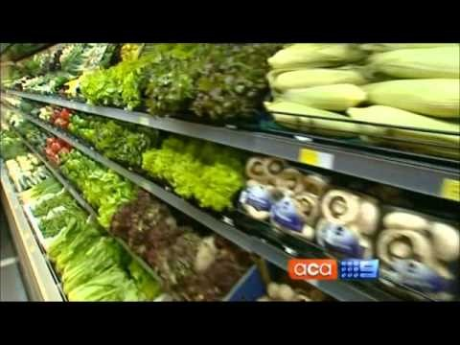
How Do Supermarkets Play Tricks on You?

Slide 11
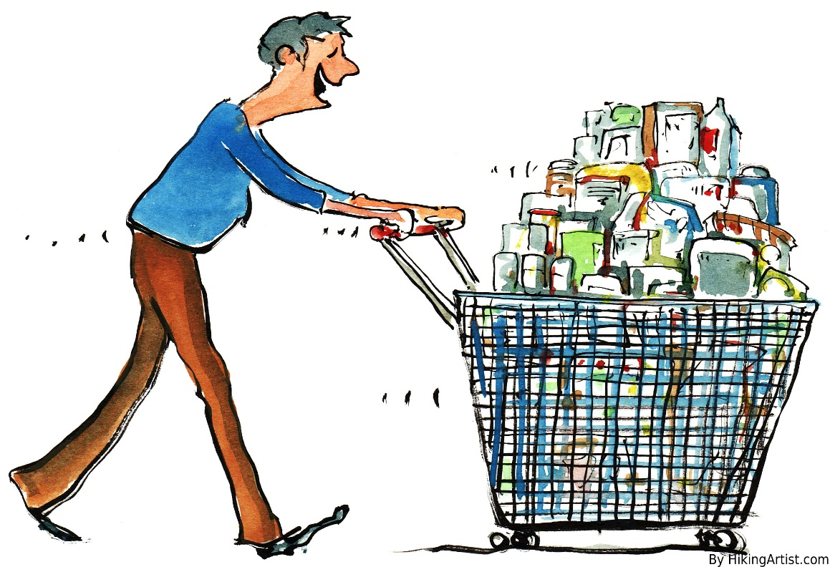
Market Order
A market order is a grocery list that tells you…
  What you need to buy based on your recipes
  Exactly how much you need to buy so you don’t buy too much or too little

Slide 12
Market Order
Market orders are arranged in categories to make shopping efficient and easy
Bread and Baked Products
Frozen
Deli and Dairy
Meat
Spices and Seasonings
Canned and Packaged Items
Produce
Miscellaneous

Slide 13
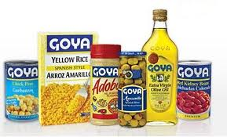
Market Order
Before you make a market order, you should check your refrigerator and pantry to see what you already have.
  Don’t Buy More Than You Need
For our project, we will assume you do not have any of the items at home.

Slide 14
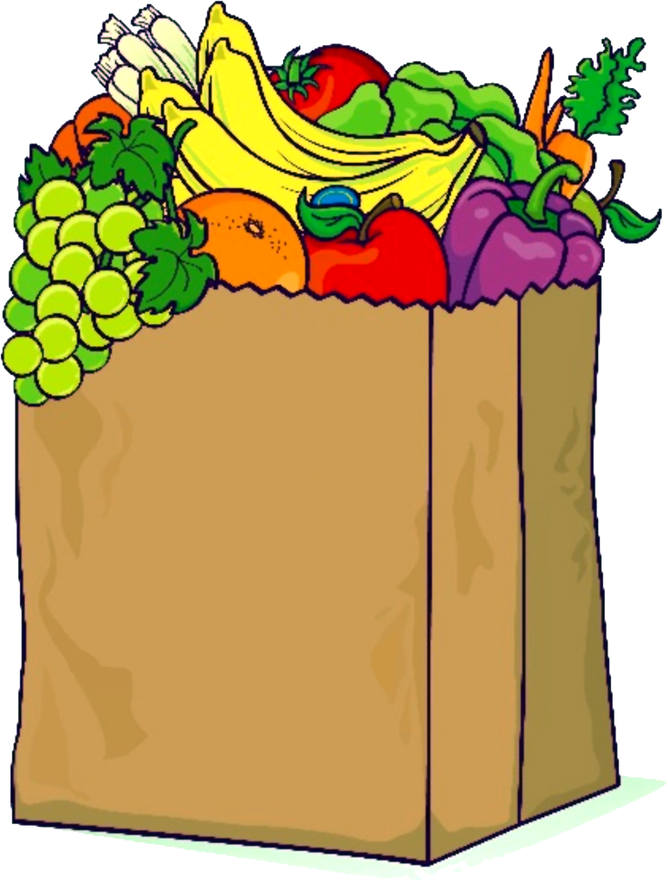
Example Market Order
Bread and Baked Products
  30 slices sourdough bread (2 loaves)
Frozen
  1 pound frozen spinach
  2 cups frozen pineapple
Deli and Dairy
  1 quart milk
Meat
  2 ½ pounds chicken breasts
Spices
  1 tsp. cinnamon
Canned and Packaged Items
  12oz. Diced tomatoes
  1 bag potato chips
Produce
  2 apples
  1 pound oranges

