Slide 1
Cooking Methods

Slide 2

How Microwaves Work

Slide 3
Dry v. Wet Cooking
Dry Cooking Methods
Grilling
Moist Cooking Methods
Steaming
Roasting
Sautéing
Broiling
Stir Frying
Pan Frying
Deep Frying
Poaching
Simmering
Stewing
Microwaving
Braising

Slide 4
Dry Cooking Methods
Dry Cooking Methods
Grilling
Roasting
Sautéing
Stir Frying
Pan Frying
Deep Frying

Slide 5
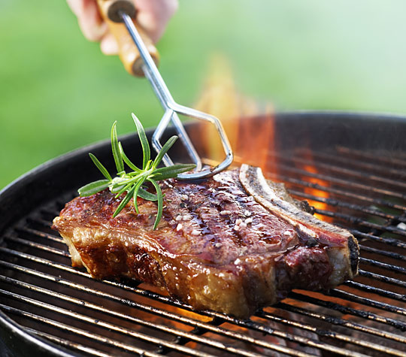
Grilling
Grilling cooks food with radiant heat from a source located below it.
Some of the juices are actually reduced directly on the food while the rest drip away.
Grilled foods have a smoky, slightly charred flavor.

Slide 6
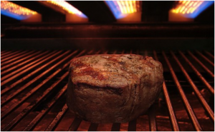
Broiling
Broiling is similar to grilling, but uses a radiant heat source located above the food rather than below.
This heat source is extremely hot! – Much hotter than the heat of an oven.
Foods are brushed with butter or oil, put on a heated, oiled sizzler pan, and then placed on the rack below the heat source.

Slide 7
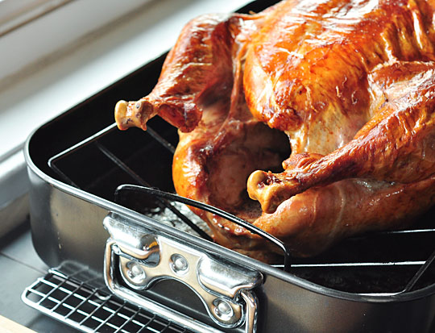
Roasting
Roasting is a way of cooking by indirect heat in an oven.
Many roasted foods are seared before baking, which is when their exterior is cooked briefly over high heat to create a brown and crispy skin.
Foods are cooked through contact with dry, heated air held in a closed environment (mainly convection, but also radiation).

Slide 8
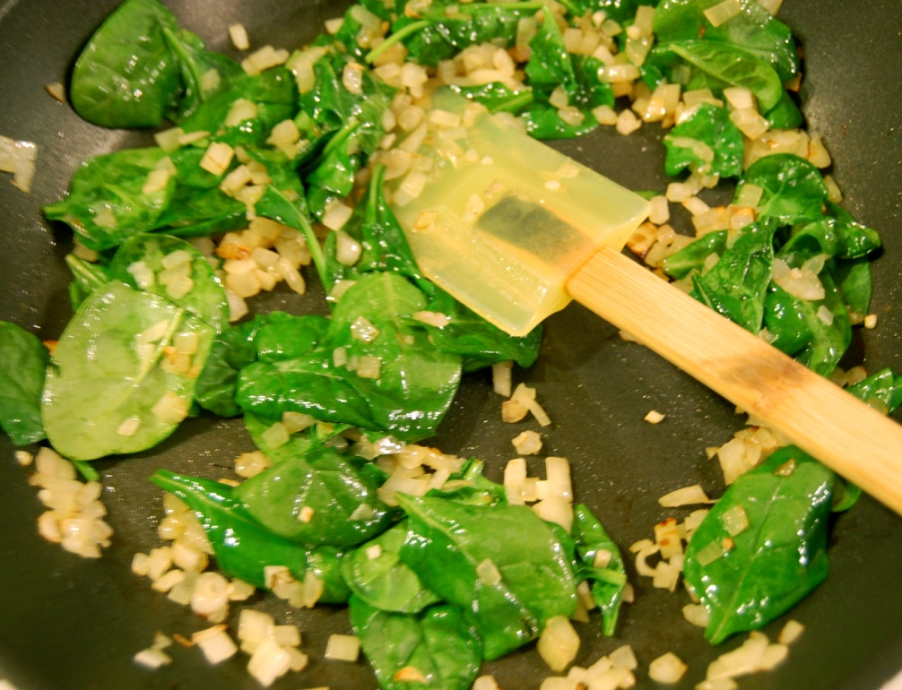
Sautéing
Sautéing is a technique that cooks food rapidly in a little fat over high heat.
The term sauté comes from the French word sauter, or “to jump.”
Mainly uses conduction to heat food

Slide 9
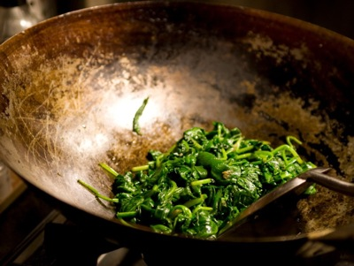
Stir Frying
Stir frying, associated with Asian cooking, shares many similarities with sautéing.
Foods are cut into small pieces and cooked rapidly in a little oil while the cook quickly stirs the ingredients.
Mainly uses conduction to heat food.

Slide 10
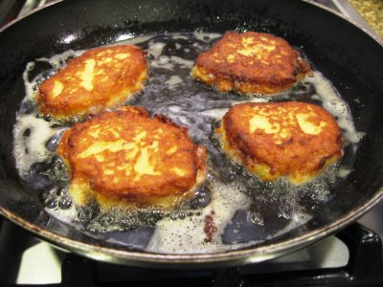
Pan Frying
Pan Frying gives foods a crunchy textured crust and a moist interior.
Pan-Fried foods are almost always coated with flour, batter, or breading.
Food is fried in enough oil to come about halfway up the side.
Uses convection and conduction to heat food.

Slide 11
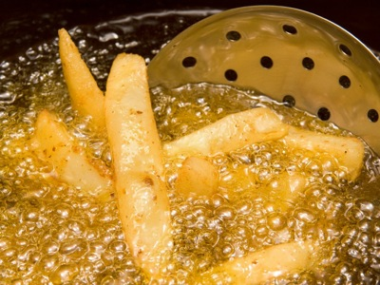
Deep Frying
Deep-fried foods are cooked in enough fat or oil to completely submerge them.
Deep fried foods have many of the same characteristics as pan-fried foods, including a crisp, browned exterior and a moist, flavorful interior.
Uses mainly convection to heat food.

Slide 12
Moist Cooking Methods
Moist Cooking Methods
Steaming
Poaching
Simmering
Stewing
Microwaving
Braising

Slide 13
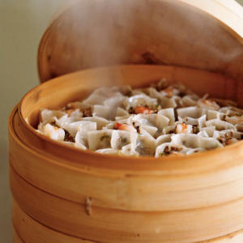
Steaming
Food is steamed by placing it in a vessel or wrapping that allows water vapor to cook the food.
Food is not submerged in liquid, it is surrounded by steam.
Uses mainly convection to heat the food.

Slide 14
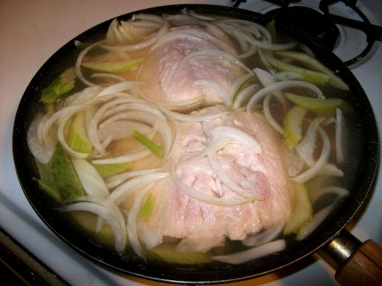
Poaching
Poaching is when foods are cooked in a simmering liquid.
This liquid can contain any number of ingredients, such as vegetables, herbs, spices, and fruits.
Poaching liquid can include oil, water, stock, wine, and other items.
The liquid is hot, but not quite simmering.
Uses convection to heat food.

Slide 15
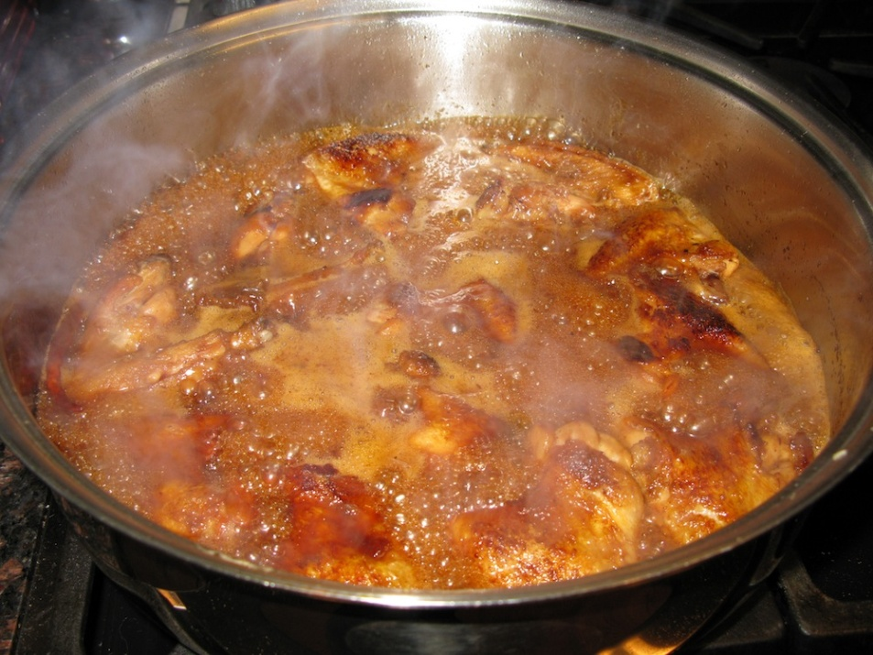
Simmering
Foods that are simmered are cooked while being completely submerged in simmering liquid.
The level of heat is higher than that of poaching.
Foods become tender and moist during cooking.
Uses convection to heat food.

Slide 16
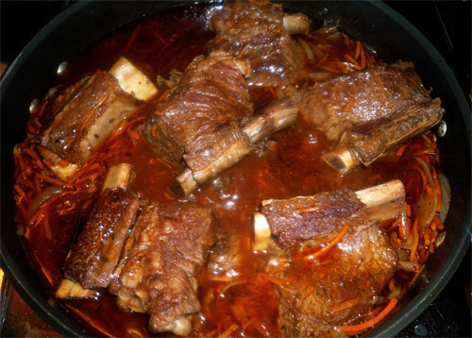
Braising
Braising involves searing food, partially covering it in liquid, and then simmering or baking it in a covered pot until done.
This is a great method for making tougher cuts of meat more tender because it softens connective tissue.
Uses convection to heat food.

Slide 17
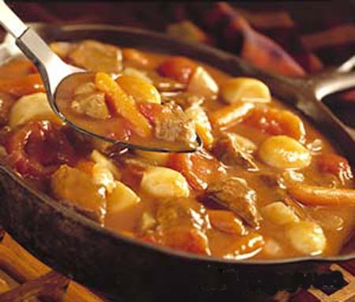
Stewing
Stewing is very similar to braising, only the foods are cut into bite sized pieces and cooked in more liquid.
Stewing is another great cooking method for tough pieces of meat due to the long moist cooking process.
Uses convection to heat food.

Slide 18
Microwaving
Microwaving is considered to be a moist heat method because it partially relies on the effects of steam.
Microwaves enter the food and cook from the outside in.
The microwaves are attracted to water, fat, and sugar and excite these molecules on the outside of the food, causing them to move back and fourth, which heats them.

Slide 19
Microwaving
The inside of the food is cooked through conduction, or by touching the hot particles on the outside of the food.
This is not the best cooking method because it can result I a rubbery texture, lack of flavor, and unappealing appearance.

Slide 20
Picture Credits
Grilling: http://www.thekitchn.com/6-steps-for-grilling-the-best-steak-of-your-life-172700
http://www.thekitchn.com/vegetarian-grilling-try-waterm-151239
Broiling: http://blog.myfavoritekitchen.com/2011/11/dry-heat-cooking-broiling/
Roasting: http://www.thekitchn.com/no-roasting-pan-160806
http://www.hogroasts.es/spit-roasts/
Sautéing: http://trialx.org/2012/11/11/spinach-saute-delicious-pictures/
Stir Frying: http://www.culinate.com/columns/bacon/how_to_stir-fry
Pan Frying: http://www.familyfriendlyfood.com/2008/11/tips-for-pan-frying/
http://www.theboldabode.com/2012/09/falafels-are-awesome.html
Deep Frying: http://www.culinate.com/columns/bacon/deep_frying
http://www.gourmet.com/food/gourmetlive/2012/080812/deep-frying-tips
Steaming: http://www.cookinglight.com/cooking-101/techniques/cooking-class-stovetop-steaming-00400000001014/
http://www.chinesechicken.net/category/steamed-dishes/
http://img.tesco.com/todayattesco/cookbook/archive/sea_bass_en_papillote.shtml
Poaching: http://cavemaneating.blogspot.com/2010/12/poaching-fish.html
http://www.food52.com/recipes/4155_olive_oil_poached_fish_or_shellfish
Simmering: http://apassionateplate.com/salty-sweet-sticky-wings/simmering-chicken-wings-in-sauce/
Braising: http://blackgirlchefswhites.com/wordpress/2009/05/12/melt-in-your-mouth-short-ribs/
http://www.slashfood.com/2010/05/19/braising-101-tip-of-the-day/
Stewing: http://english.eastday.com/e/cy/userobject1ai4037696.html
http://justhungry.com/image/curry-stewing-pot

